Slide 1
PLASTIC OCEANS, CAN MICROBES CLEAN UP OUR MESS?
VINKO ZADJELOVIC AND ROBYN WRIGHT

Slide 2
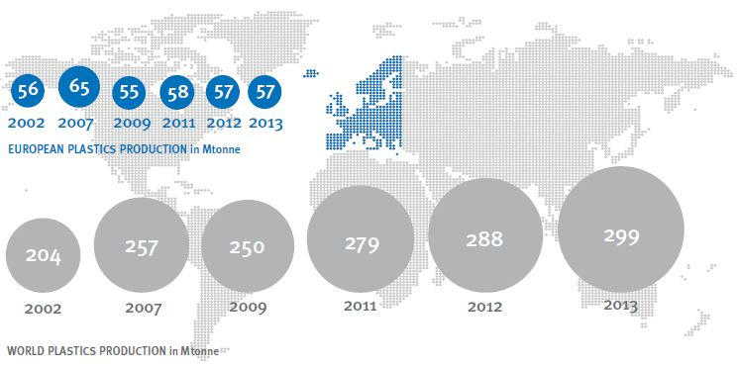
“Like many anthropogenic impacts on natural systems, it is one that, despite widespread recognition of the problem, is still growing and even if stopped immediately will persist for centuries”
(Barnes et al., 2009)
“Missing microplastic may derive from nano-fragmentation processes, rendering the very small pieces undetectable to convectional sampling nets, and/or may be transferred to the ocean interior”
(Cózar et al., 2014)
“…275 million metric tons (MT) of plastic waste was generated in 192 coastal countries in 2010, with 4.8 to 12.7 million MT entering the ocean”
(Jambeck et al., 2015)

Slide 3
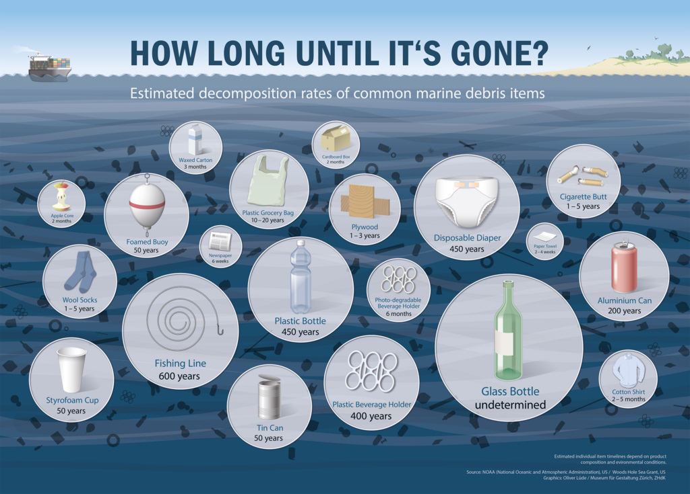
Jambeck et al. (2015)
Notes:
Jambeck et al. looked at all of the waste that could potentially be entering the oceans from all coastal countries, and determined how much of this was likely to be entering the ocean. They worked this out as 4.8 to 12.7 MT, which is troubling considering that we know that plastic can take hundreds of years to break down in the oceans...

Slide 4
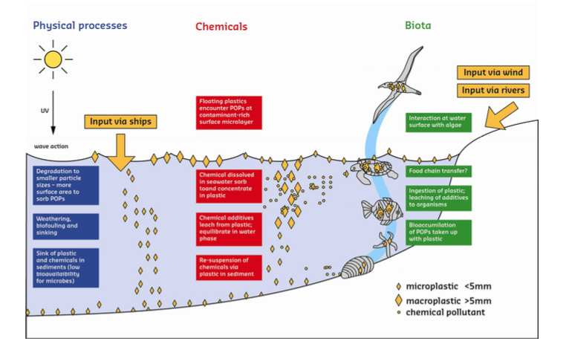
Leslie et al., 2011
Notes:
Plastic doesn’t only end up in the sea via mismanaged waste, and once in the oceans, it can break down further, into smaller and smaller pieces. These smaller pieces are then accessible to a wider range of organisms than the original, large plastics were. Some plastic directly enters the oceans as microplastics, such as exfoliating beads from facial cleansers. We are mainly focusing on these microplastics, as we think their larger surface area to volume ratio should make them more accessible for biodegradation.

Slide 5
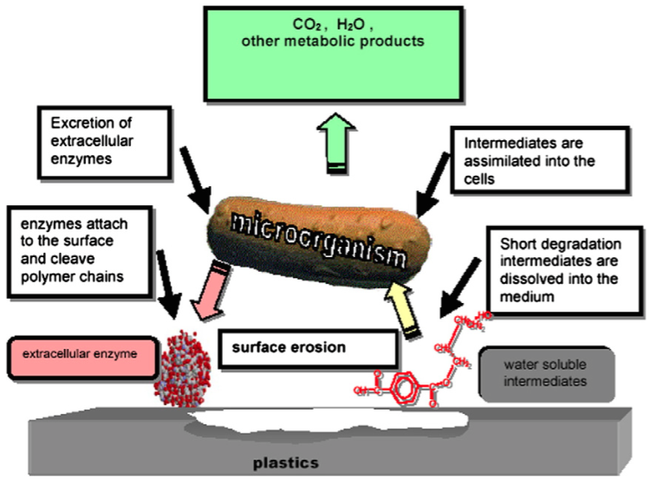
PLASTIC BIODEGRADATION
Shah et al., 2008
Notes:
Biodegradation is generally considered to be carried out primarily through the excretion of extracellular enzymes by bacteria, which lead to the breakdown of the polymers (in this case) and then once the chains are short enough, they may be taken into the cells.

Slide 6
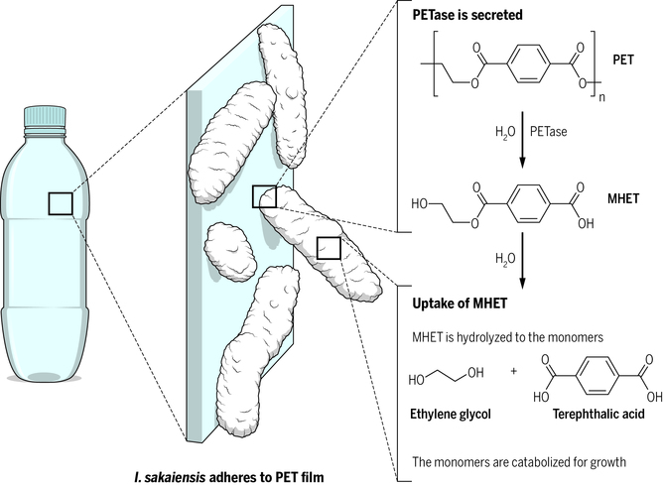
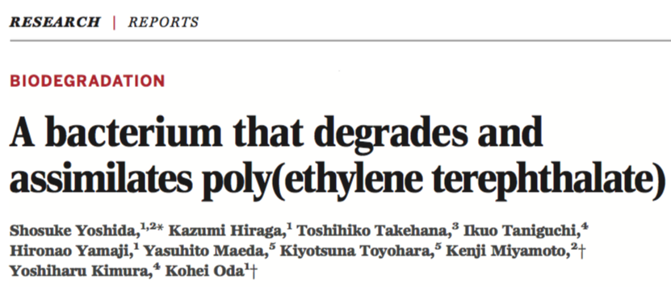
Notes:
This idea was recently demonstrated by Yoshida et al., in a Science paper, where they isolated a bacteria from a plastic bottle factory in Japan, and found that it was able to survive using only PET as a carbon source. They determined the pathway for this, and found that the bacteria used two major enzymes in order to be able to grow on PET; PETase, which broken down the long polymer chains of PET to MHET (mono hydroxy ethylene terephthalate) and then MHETase to further break this down to its constituent monomers, which it can then use for growth.

Slide 7
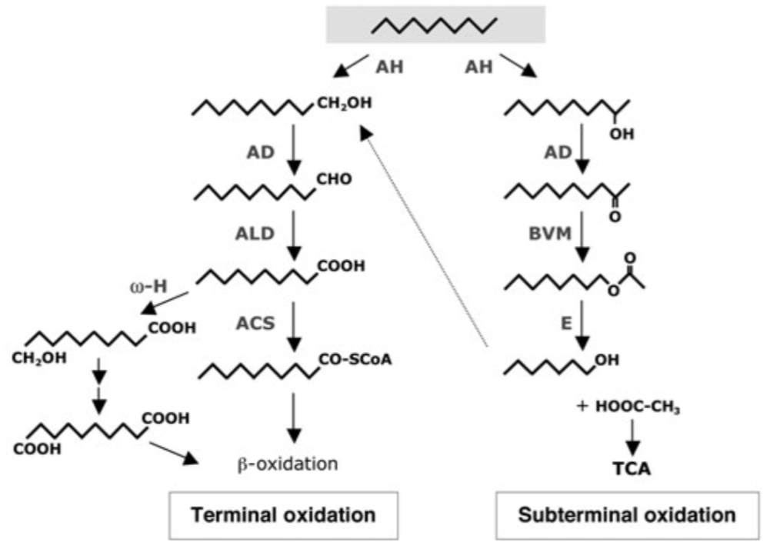
Plastic biodegradation
Rojo, 2009
Shah et al., 2008

Slide 8
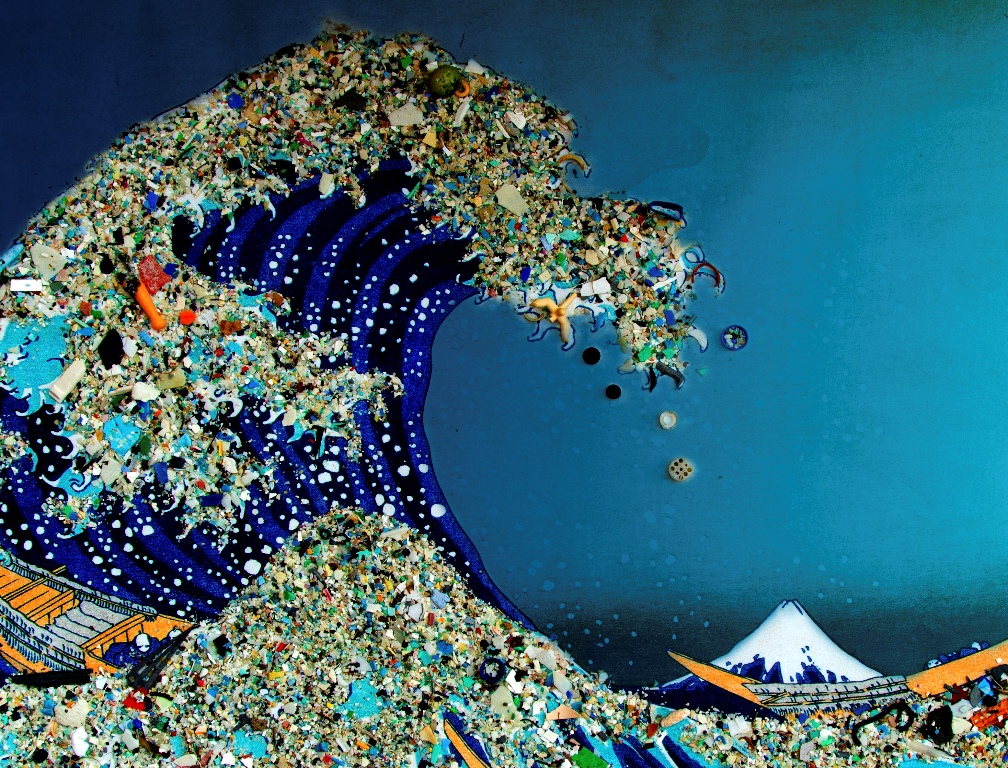
WHAT ARE WE TRYING TO ACHIEVE, AND HOW ARE WE TRYING TO ACHIEVE IT?
Notes:
These theories have been demonstrated now in several terrestrial bacteria and fungi, but given that we know how much plastic is ending up in the ocean, we would like to see if marine microorganisms could also degrade plastics.
Our hypothesis is that: Plastic is a new potential source of carbon for marine microorganisms that can be degraded by enzymes that normally degrade natural polymers. These enzymes will evolve to degrade these novel synthetic polymers and incorporate the resulting oligomers as a novel source of carbon and energy.
So, we have a couple of different approaches to this...

Slide 9
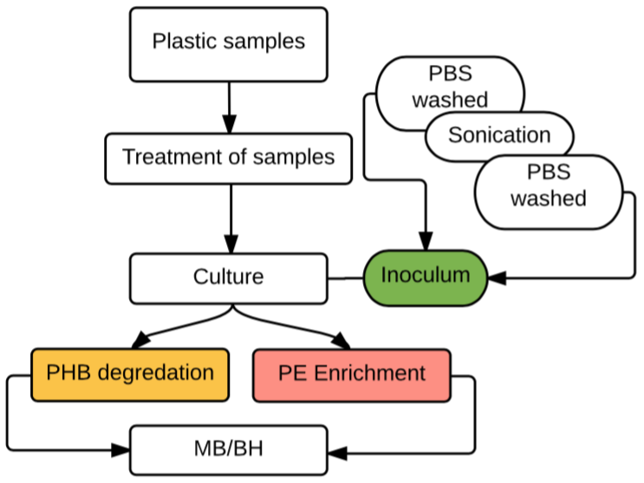
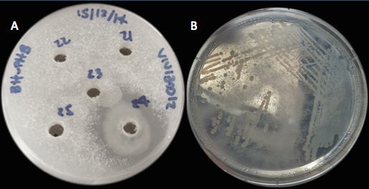
ISOLATION PROCEDURES
Code | Blast (type strain filter) | Max identity % | Poymer sample | Isolation method
Strain 6 | Pseudoalteromonas shioyasakiensis | 99 | PE bag + Plastic net | PHB plates
Strain 24 | Alcanivorax dieselolei B5 | 99 |  | PHB plates
Strain I2 | Halomonas sp. HL-93 | 98 | Plastic net | PE-Enrichment
Strain S1 | Halomonas sp. HL-93 | 98 | Rubber like | PE-Enrichment
Gene name | Product
alkB1_1 | Alkane 1-monooxygenase 1
alkB1_2 | Alkane 1-monooxygenase 1
alkB2 | Alkane 1-monooxygenase 2
alkJ | Alcohol dehydrogenase [acceptor]
rubB | Rubredoxin-NAD(+) reductase
rubA2 | Rubredoxin-2
Clear zone formation, plates BH-PHB 3,5% NaCl.

Slide 10
C50 before inoculum
C50 after inoculum
Fig. 3. Alkanes culture condition. Picture A shows the condition if the culture before incubation, where the alkanes was continually over the surface event when shaking. Picture B shows the condition of the culture after incubation, where it can be seen that the alkanes are in emulsion with the aqueous media.
Fig. 6. UHMWPE culture conditions. In picture A and B show the residual substance left at the end of the experiment (after recovering the media). As it can be seen the substance biofilm-like apparently is a mix of cellular composition and PE aggregates.

Slide 11
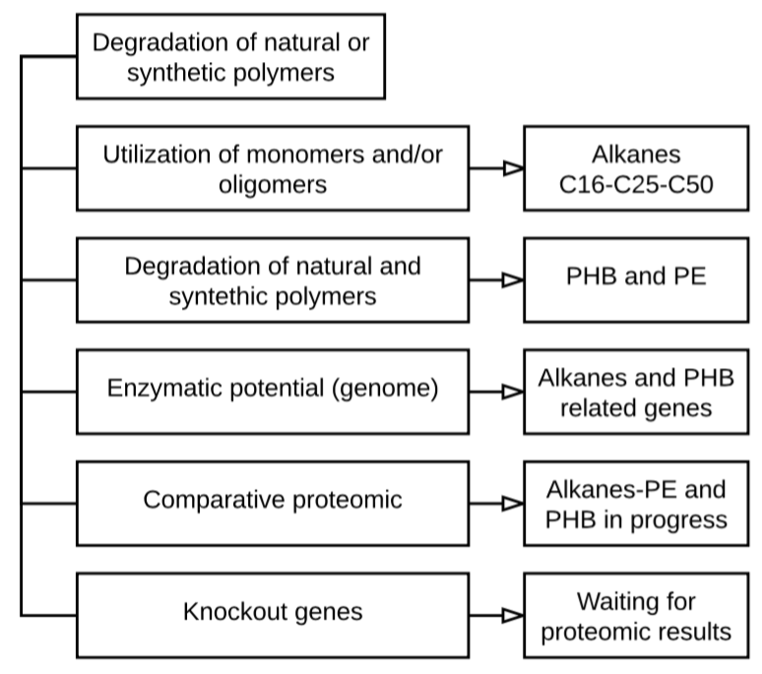

Slide 12
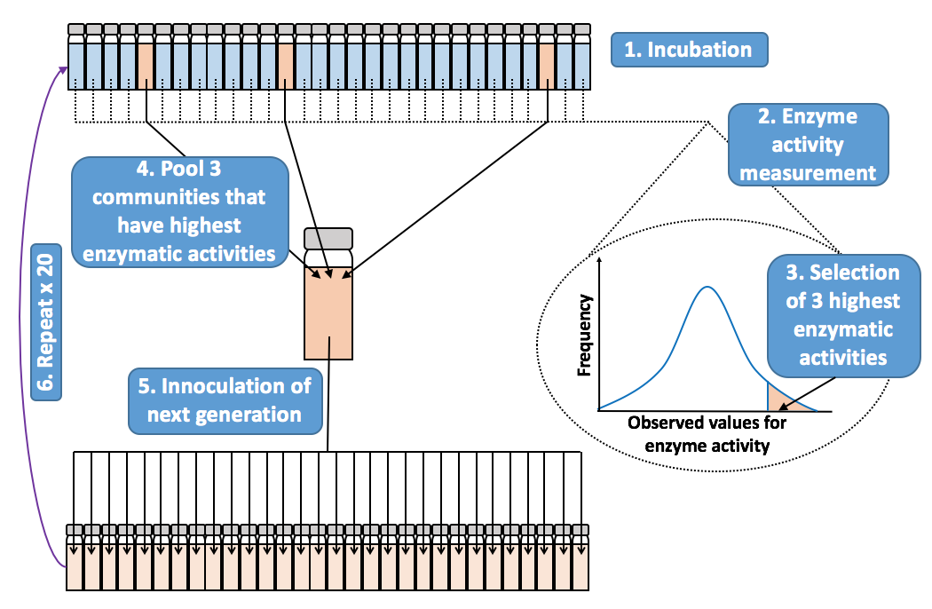
ARTIFICIAL EVOLUTION
Notes:
So, Vinko is looking to isolate what is already there, and test its degradative potential, but I am looking to see if we can artificially evolve, or select, a bacterial community that is better at degrading polymers than the natural environmental community. To do this, I incubate 30 communities, for a fixed generation time, before determining which communities should be the best degraders based upon their enzymatic activity. I then pool the 3 best communities and use them to inoculate my next generation. The idea is here, that at each generation, they should become better degraders, and I compare this to what happens if I select the community at random.
The method for testing for degradation needed to be simple enough that I could use it on a large amount of samples all at the same time, so I decided to measure enzymatic activity, as an indicator of how good a community is at degradation of a particular polymer. Basically, I have 30 communities in a generation, and at the end of the generation, I measure the enzyme activity, and then pool the 3 communities with the highest activity for innoculation of the next generation. The idea is to repeat this over 20 generations, and hopefully end up with a community that is better at degradation than the initial starting community.
Using different treatments – light, dark, dark random and a known degrader.

Slide 13
PET – generation 1
Selected at random – can see from lack of colour that there is little growth
Highest enzyme activities selected

